Slide 1




CLASSIFICATION CHALLENGE ON ALZHEIMER’S DISEASE USING MRIS AND GENE EXPRESSION DATA
Presentation by:
Daniel Tweneboah Anyimadu
Statistical Learning & Data Mining | 2023
University of Girona, University of Bourgogne, and University of Cassino

Slide 2

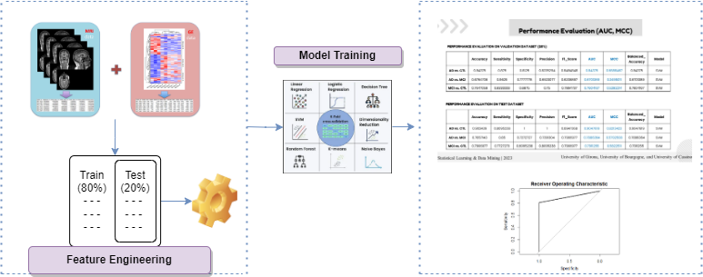

ABSTRACT
The study employs a statistical learning approach involving data analysis, feature engineering, and machine learning model training using 10-fold cross-validation.
The models are evaluated based on several evaluation metrics. However, AUC and MCC are utilized for performance evaluation of the model.
The best performing model, SVM achieved AUC and MCC scores of 0.9047619 and 0.8213423 respectively on the ADCTL test dataset, 0.7886364 and 0.5792508 on the ADMCI, and 0.7911255 and 0.5822511 on the MCICTL.
This project aims to classify Alzheimer's Disease (AD) into three stages: controls (CTL), mild cognitive impairment (MCI) and AD using MRI and Gene Expression (GE) data.
Various algorithms, including CART, K-NN, SVM, Random Forest, Logistic Regression, and Linear Discriminant Analysis, are leveraged for the classification tasks, AD vs CTL, AD vs MCI and MCI vs CTL.

Slide 3
Train-Test Split & Feature Engineering
Train-Test Split:
Performed train-test split by creating subsets of the original training data (ADCTL, ADMCI, MCICTL).
This was split into 80% training, while the remaining 20% formed the validation dataset.
A seed value of 1234 for (ADCTL, MCICTL) and 7 for (ADMCI) were set to ensure consistent randomization.
Feature Engineering
~ Normalization:
Performed standard scaling to normalize the feature variables.
This was to facilitate a fair comparison across different features.
~ Dimensionality Reduction:
Applied principal component analysis (PCA) to reduce data dimensionality.
PCA components of 50 (ADCTL), 10 (ADMCI) and 70 (MCICTL) were respectively selected from each dataset.
This also helped minimize reconstruction error by selecting most informative features for the task.
Statistical Learning & Data Mining | 2023
University of Girona, University of Bourgogne, and University of Cassino

Slide 4
Machine Learning (Model Training)
Machine Learning Models:
This adjusts the model parameters to minimize the difference between the predicted and actual labels of the target variable.
Non-linear algorithms:
~ Classification and Regression Trees (CART)
~ K-Nearest Neighbors (KNN)
~ Support Vector Machines (SVM), with radial kernel
Advanced algorithms:
~ Random Forest (RF)
Linear algorithms:
~ Logistic Regression
~ Linear Discriminant Analysis
Statistical Learning & Data Mining | 2023
University of Girona, University of Bourgogne, and University of Cassino

Slide 5
Performance Evaluation (AUC, MCC)
PERFORMANCE EVALUATION ON VALIDATION DATASET (20%)
 | Accuracy | Sensitivity | Specificity | Precision | F1_Score | AUC | MCC | Balanced_Accuracy | Model
AD vs. CTL | 0.84375 | 0.875 | 0.8125 | 0.8235294 | 0.8484848 | 0.84375 | 0.6888467 | 0.84375 | SVM
AD vs. MCI | 0.6764706 | 0.5625 | 0.7777778 | 0.6923077 | 0.6206897 | 0.6701389 | 0.3495011 | 0.6701389 | SVM
MCI vs. CTL | 0.7647059 | 0.8333333 | 0.6875 | 0.75 | 0.7894737 | 0.7604167 | 0.5282214 | 0.7604167 | SVM
PERFORMANCE EVALUATION ON TEST DATASET
 | Accuracy | Sensitivity | Specificity | Precision | F1_Score | AUC | MCC | Balanced_Accuracy | Model
AD vs. CTL | 0.902439 | 0.8095238 | 1 | 1 | 0.8947368 | 0.9047619 | 0.8213423 | 0.9047619 | SVM
AD vs. MCI | 0.7857143 | 0.85 | 0.7272727 | 0.7391304 | 0.7906977 | 0.7886364 | 0.5792508 | 0.7886364 | SVM
MCI vs. CTL | 0.7906977 | 0.7727273 | 0.8095238 | 0.8095238 | 0.7906977 | 0.7911255 | 0.5822511 | 0.7911255 | SVM
Statistical Learning & Data Mining | 2023
University of Girona, University of Bourgogne, and University of Cassino

Slide 6
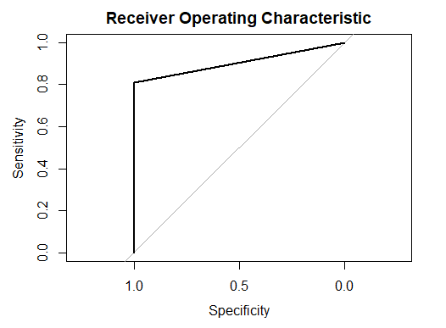
Conclusion
The results of the SVM with radial function kernel model on the 20% validation and actual test data outperformed all other models.
Feature engineering (scaling and PCA) seem to have a significant impact in improving the model’s performance as it helps to facilitate a fair comparison across different features while also selecting most informative features for classification tasks.
Statistical Learning & Data Mining | 2023
University of Girona, University of Bourgogne, and University of Cassino

